Slide 1
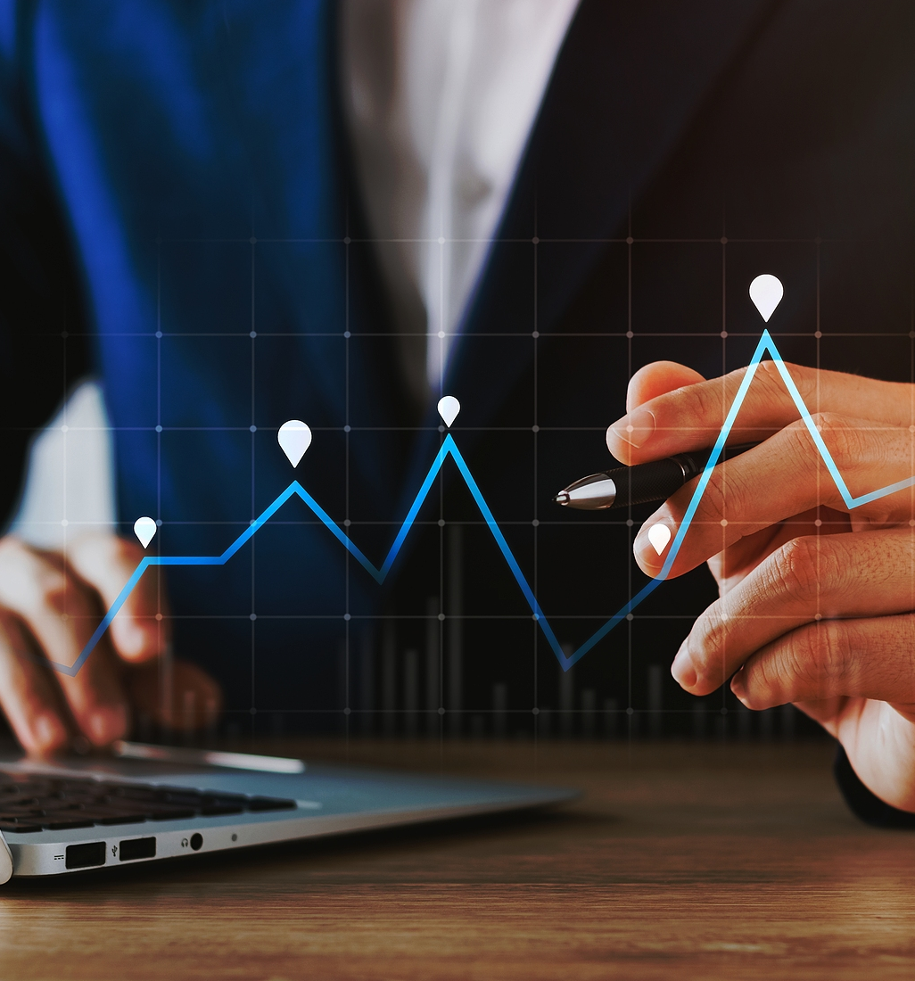

BG WEALTH
SHARING GROUP
Invest once in DSJ Exchange and benefit for life

Slide 2


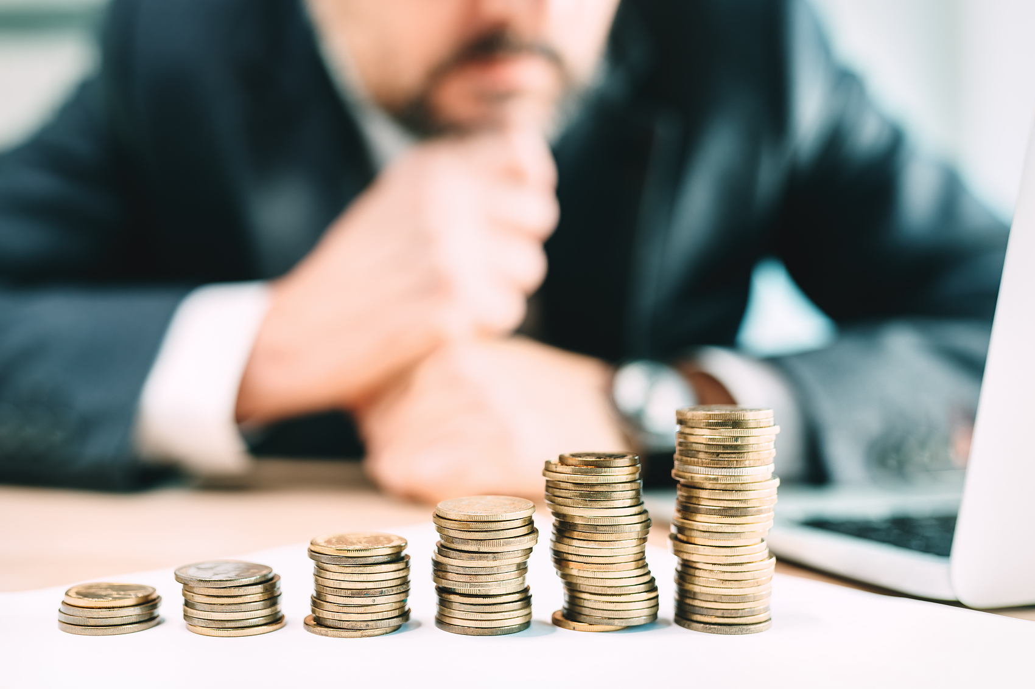
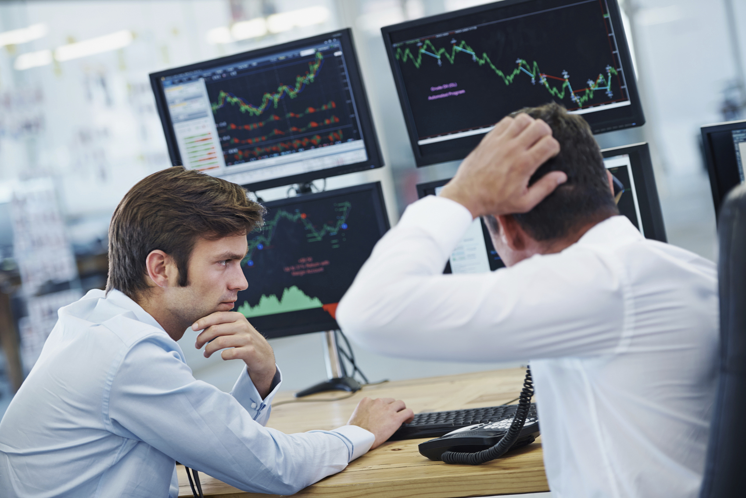
WHAT IS THE WEALTH
SHARING FUND?
The Wealth Sharing Fund Team is a long-term investment where all members who join the team can increase their profits by building the team.
Through trading signals, there are many additional sources of income
Earning Stable Income
This requires everyone to understand
the advantages of the team and learn
how to enhance them.
BG WEALTH SHARING GROUP

Slide 3

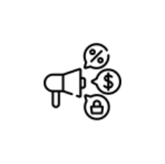
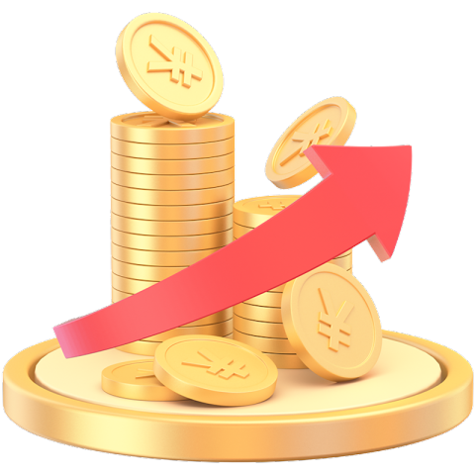
THE TRIPARTITE WIN-
WIN STRUCTURE
First: Investors
Investors profit daily by following my shared optimal trading points, which have a precision rate of over 99.6%, ensuring long- term gains. Details in further slides.
Second: Guiding Leader
The Guiding leader, Professor Stephen Beard, of the Wealth Sharing Fund team enhances the trading volume and visibility of the exchange by guiding team members with these trading signals. DSJ Exchange (DSJEX) rewards 30% team trading commission.
Third: DSJ Exchange
DSJ Exchange benefits from the promotion by investors, gaining more members and providing a stable investment platform.
This creates a healthy and stable cycle of cooperative benefits.
When you trade $100, you can earn a minimum profit of $65, while DSJ Exchange earns the remaining $35 as the spread. Additionally, DSJ Exchange charges a
withdrawal fee on each transaction made by its members.
This creates a healthy and stable cycle of cooperative benefits.
When you trade $100, you can earn a minimum profit of $65, while DSJ Exchange earns the remaining $35 as the spread.
Note: DSJ Exchange charges a withdrawal fee on each transaction made by its members.
BG WEALTH SHARING GROUP

Slide 4
FIVE MAJOR ADVANTAGES OF THE
WEALTH SHARING FUND TEAM
演亦文化
Long term stable income, the world's
unique Al trading data combined with signal winning rate calculation is high as 99.6% or more.
1
DSJ Exchange holds licenses and business licenses from more than 30 countries and regions around the world, including the US (SEC) license, the Australian (ASIC) license, the Monetary Authority of Singapore (MAS) license, the Dubai Financial Services Authority (DFSA) license, and the Central Bank of the Bahamas license.
演亦文化
2
Guaranteed fund protection: BG Fund Company was established in 2024 with an initial capital of 30 million pounds, ensuring the safety of all members' funds. All details for BG Fund Company and Professor Stephen Beard’s credentials are officially available.
演亦文化
3
Long-term project partnership: We have signed a ten-year cooperation plan with DSJ Exchange, the core of which is to create a win-win situation for all parties involved.
演亦文化
4
演亦文化
Future income will be more diversified. In addition to profiting from signal trading, you can also form a team to obtain additional income opportunities.
5
BG WEALTH SHARING GROUP

Slide 5
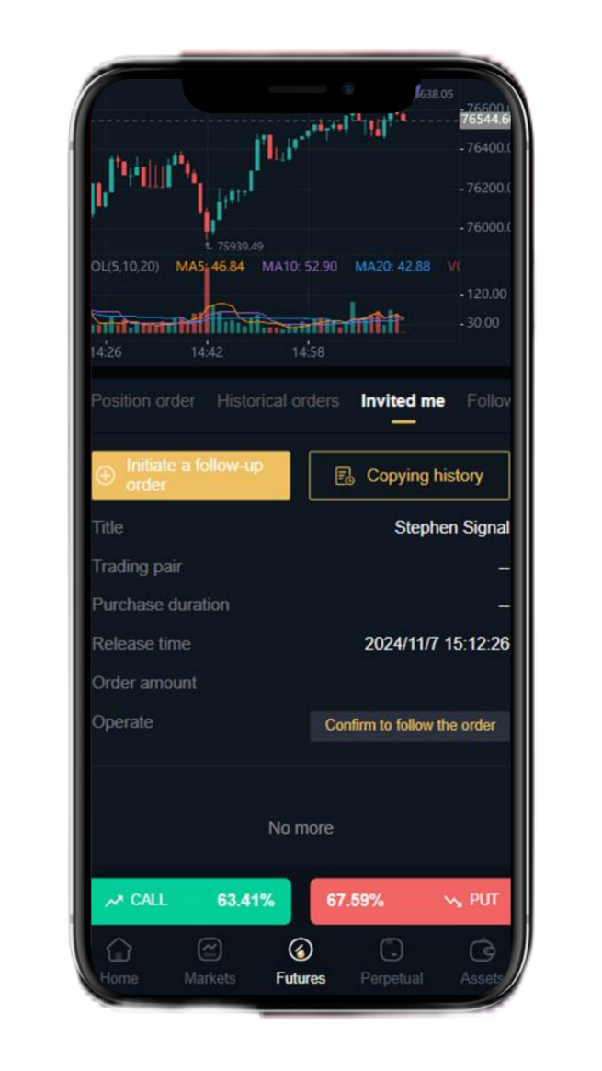
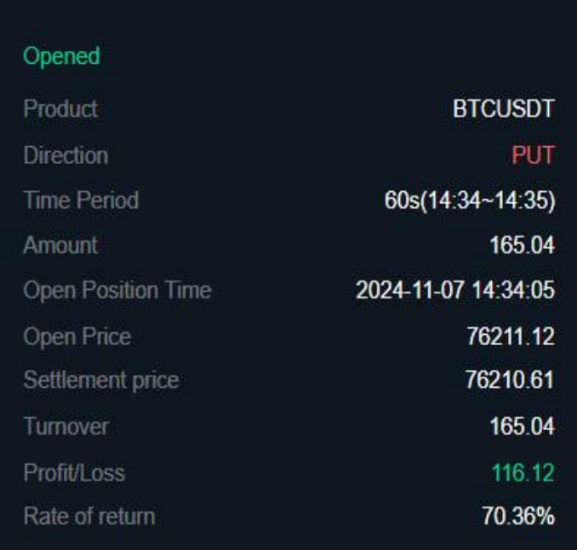

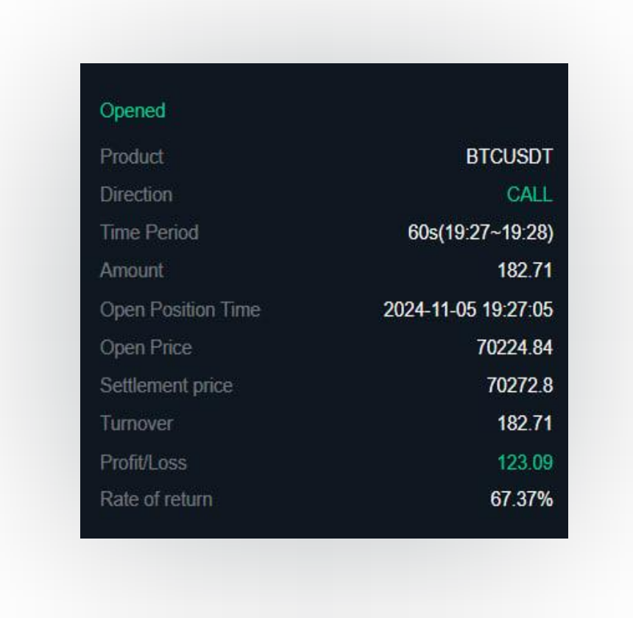
ADVANTAGE ONE
The world's unique intelligent AI data collection system, combined with professional analysis and calculation, has a signal trading accuracy rate of up to 99.6% .
Members who join the team can guarantee stable returns following Professor Stephen every day.
o o o http://www.website.com
o o o http://www.website.com
BG WEALTH SHARING GROUP

Slide 6
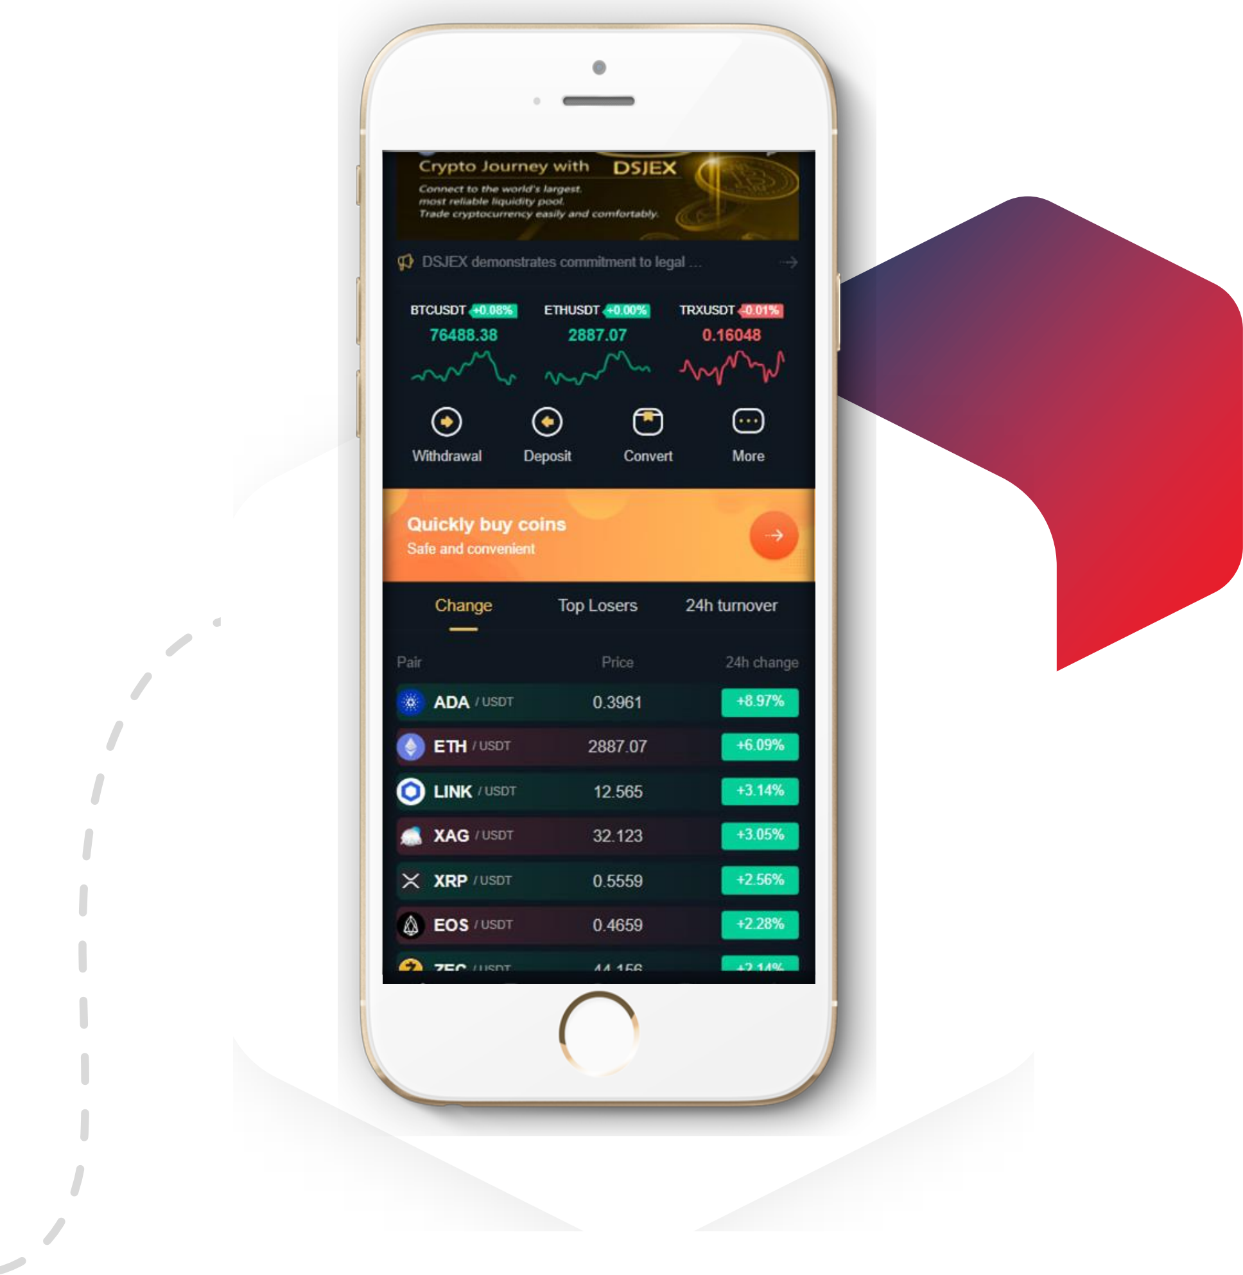
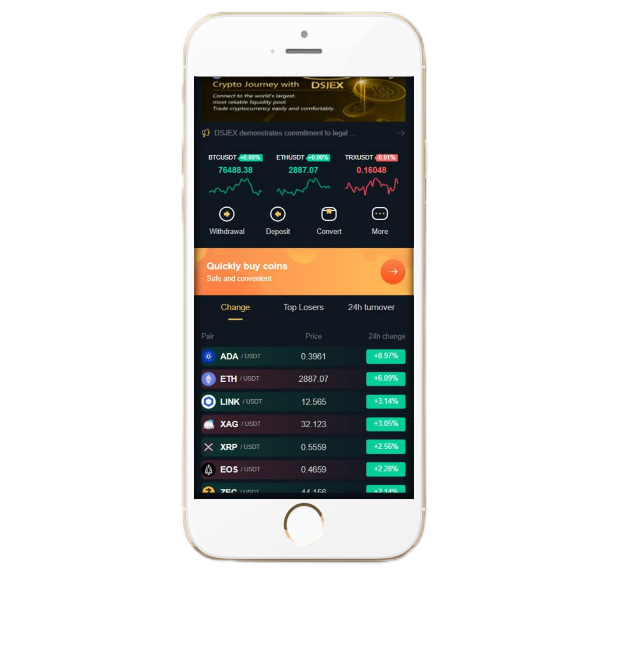
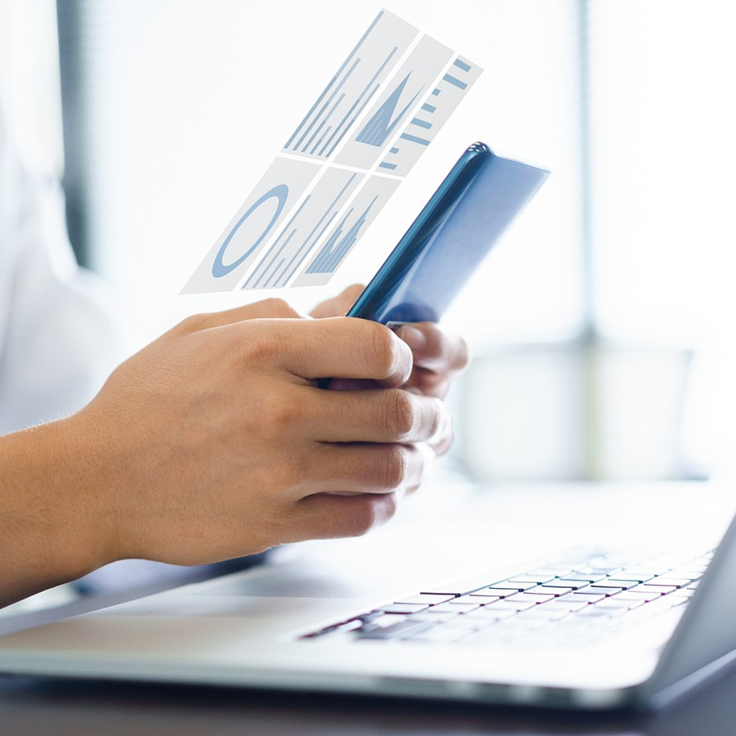
ADVANTAGE ONE
BG WEALTH SHARING GROUP

Slide 7
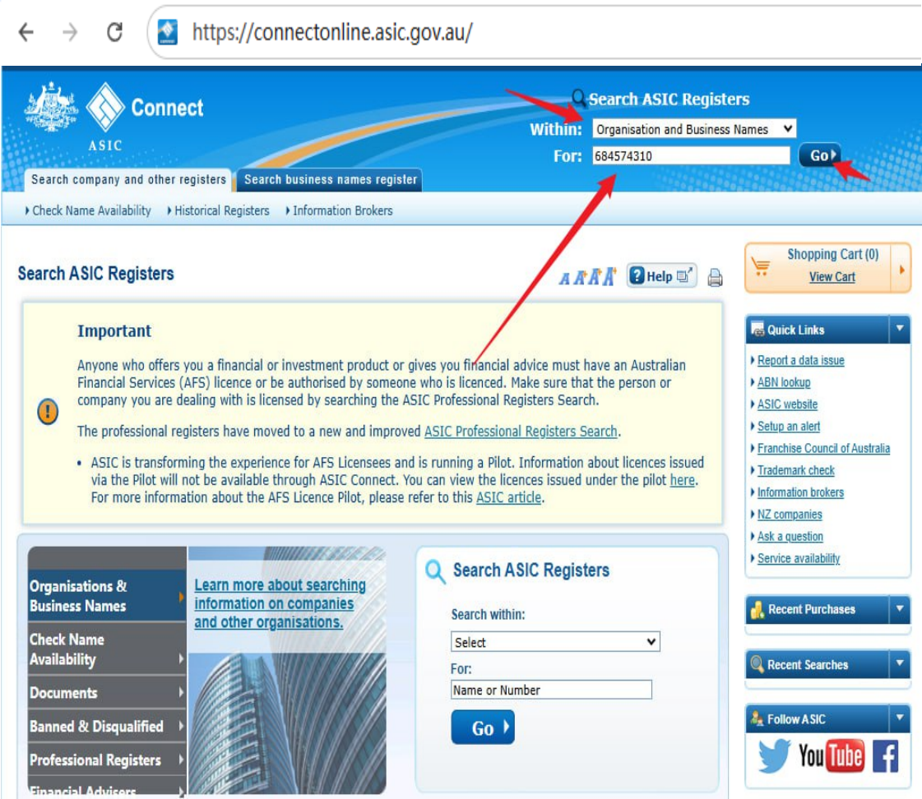
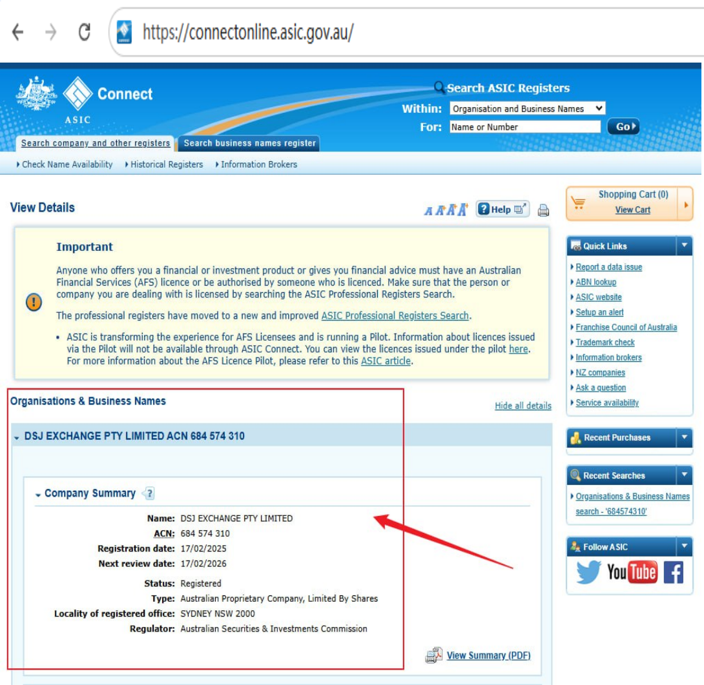
ADVANTAGE TWO
The DSJ exchange platform has an Australian license and is directly regulated by the Australian government. It can provide experiential financial services on a global scale and protect the financial security of every investor in accordance with the law.
Every user's funds on the DSJ exchange are protected at the highest level of security.
We not only trade under legitimate regulations but also ensure there are no inaccessible funds.
This guarantees that everyone can
legally and compliantly earn money
through this project,
ensuring peace of mind for all participants!
BG WEALTH SHARING GROUP

Slide 8
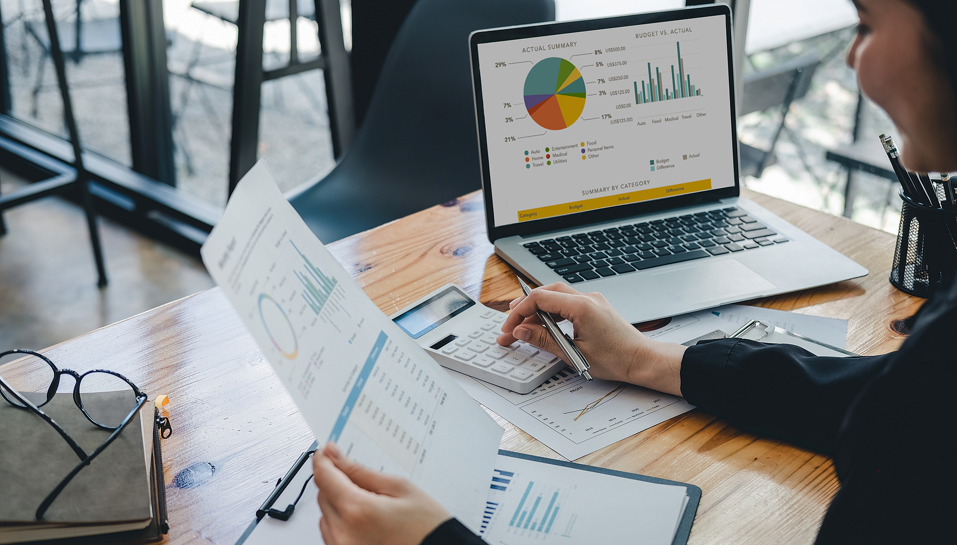
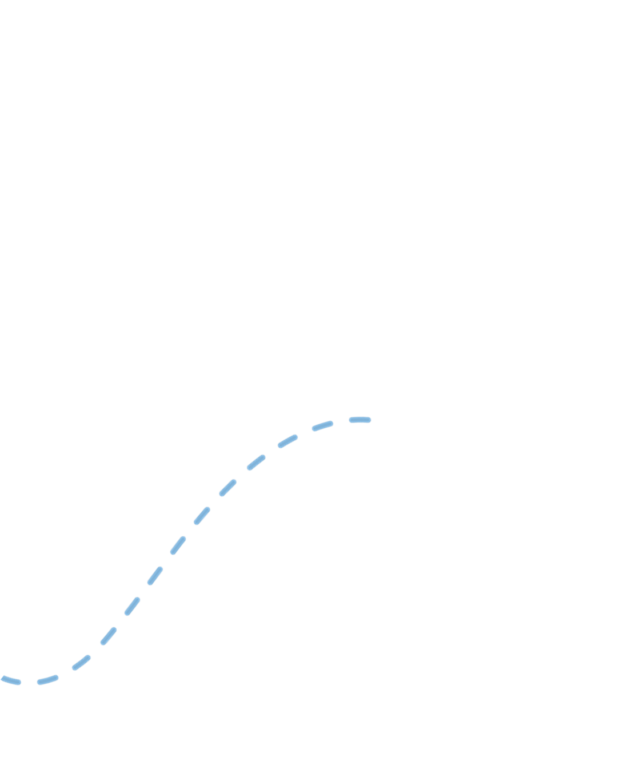
ADVANTAGE TWO
BG WEALTH SHARING GROUP

Slide 9
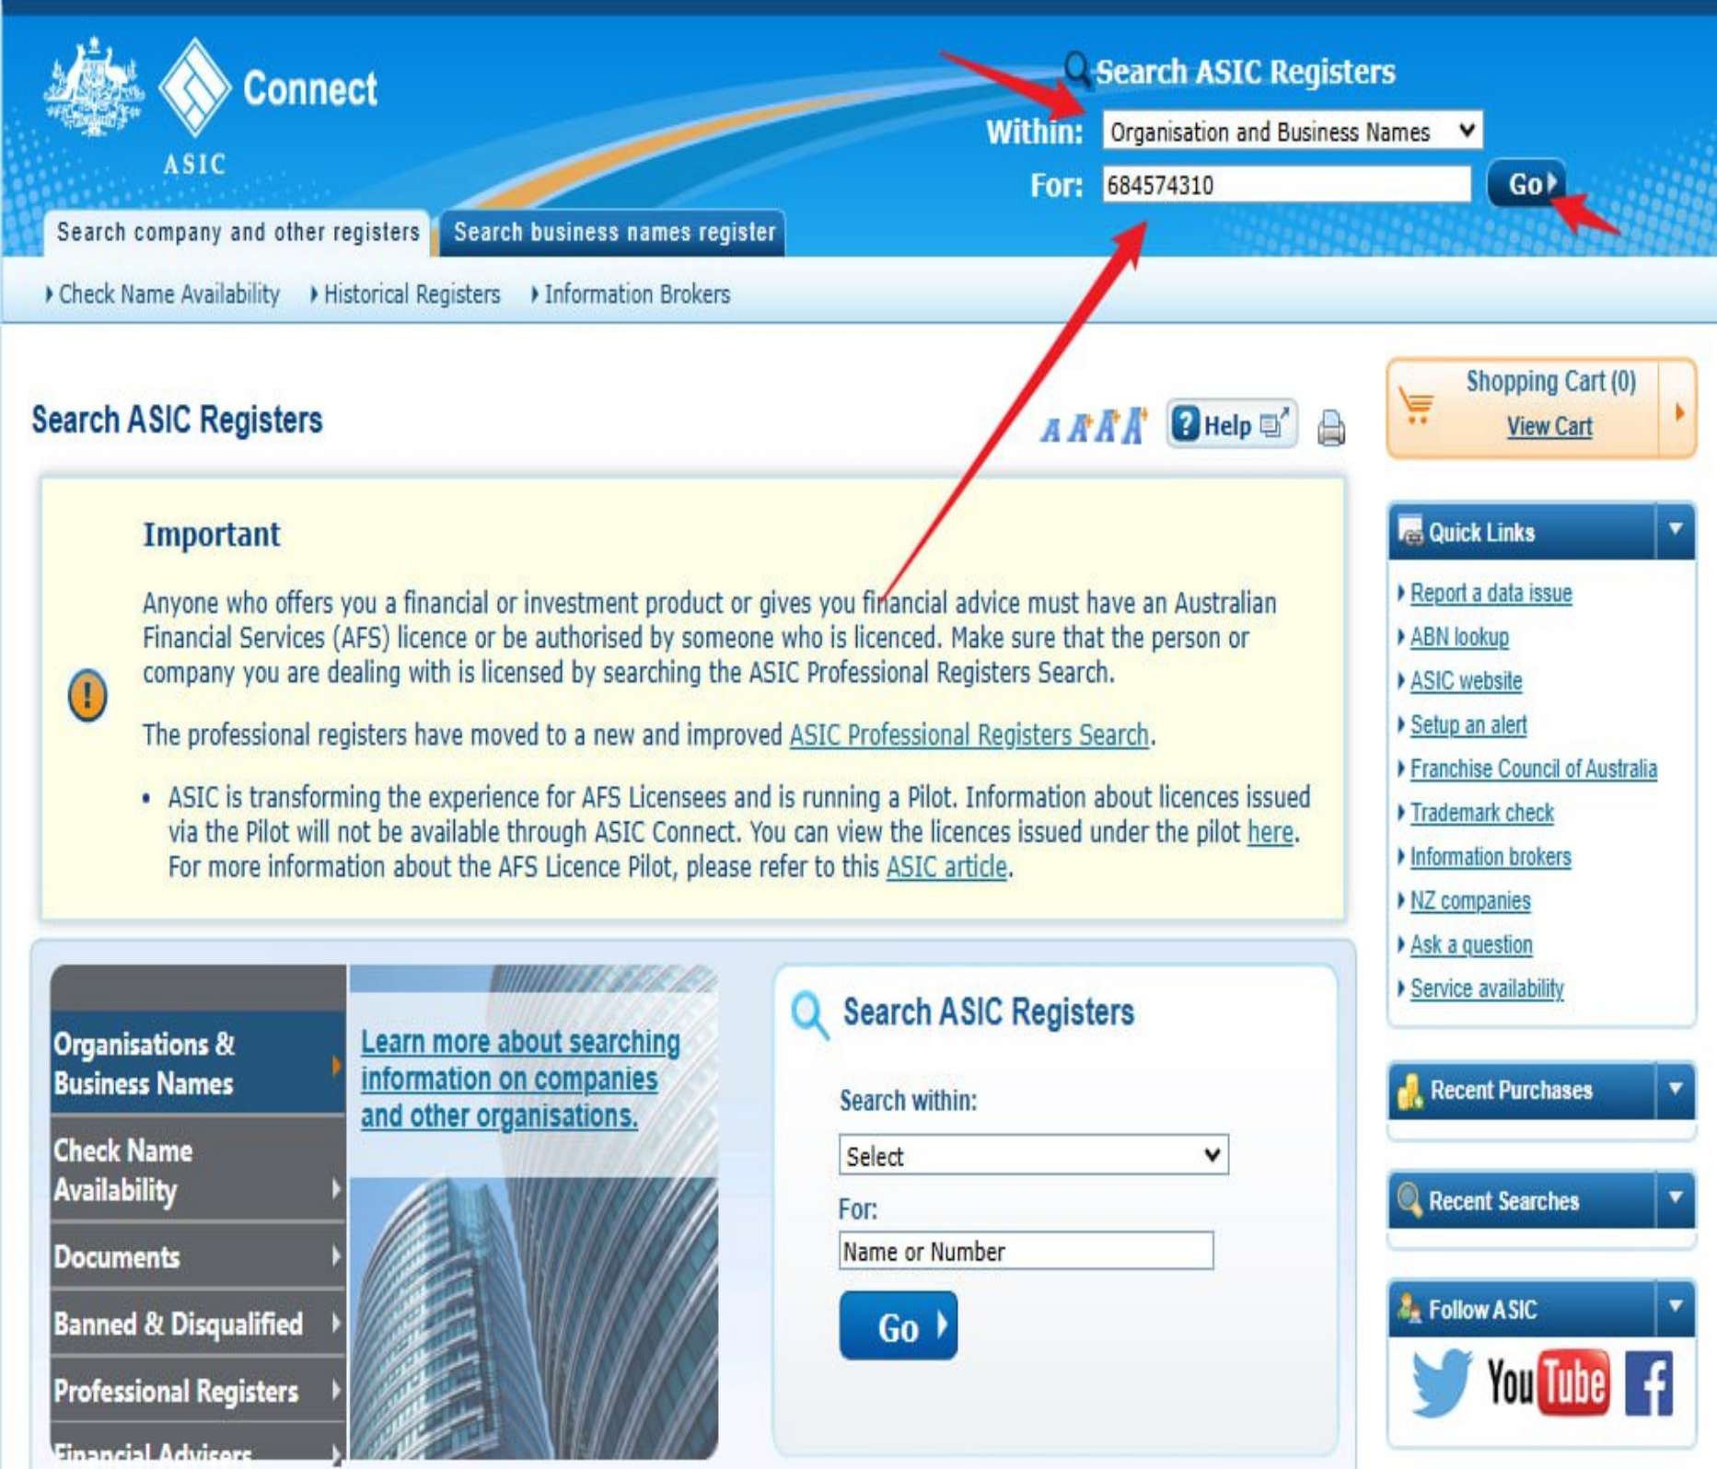
ADVANTAGE TWO
https://connectonline.asic.gov.au
BG WEALTH SHARING GROUP

Slide 10


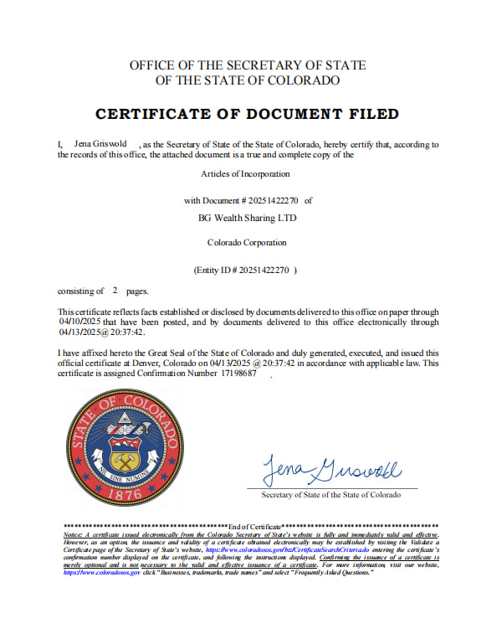

ADVANTAGE THREE
Security of team members‘ funds is guaranteed.
April 13
On April 13, 2025, BG Wealth Sharing Fund Company was officially approved by the Colorado Secretary of State, and obtained legal license certification with a capital injection of US$70 million. This also indicates that the professionalism and legality of BG Group have been most authoritatively recognized in the industry. In the future, it will work with members from all over the world to create new wealth together!
On August 19, 2024 officially passed the formal approval from the UK GOV department, with a capital injection of 30 million pounds to obtain the legal license certification, which also marks the BG Group's professionalism and legitimacy in the industry has been the most authoritative recognition of the future will be hand in hand with members from all over the world, and together we will create a new wealth!
On August 19, 2024 officially passed the formal approval from the UK GOV department, with a capital injection of 30 million pounds to obtain the legal license certification, which also marks the BG Group's professionalism and legitimacy in the industry has been the most authoritative recognition of the future will be hand in hand with members from all over the world, and together we will create a new wealth!
2024 officially passed the formal approval from the UK GOV department, with a capital injection of 30 million pounds to obtain the legal license certification, which also marks the BG Group's professionalism and legitimacy in the industry has been the most authoritative recognition of the future will be hand in hand with members from all over the world, and together we will create a new wealth!
The fund company and my information areo fficially verifiable.
The fund company and my information are officially verifiable.
BG WEALTH SHARING GROUP

Slide 11
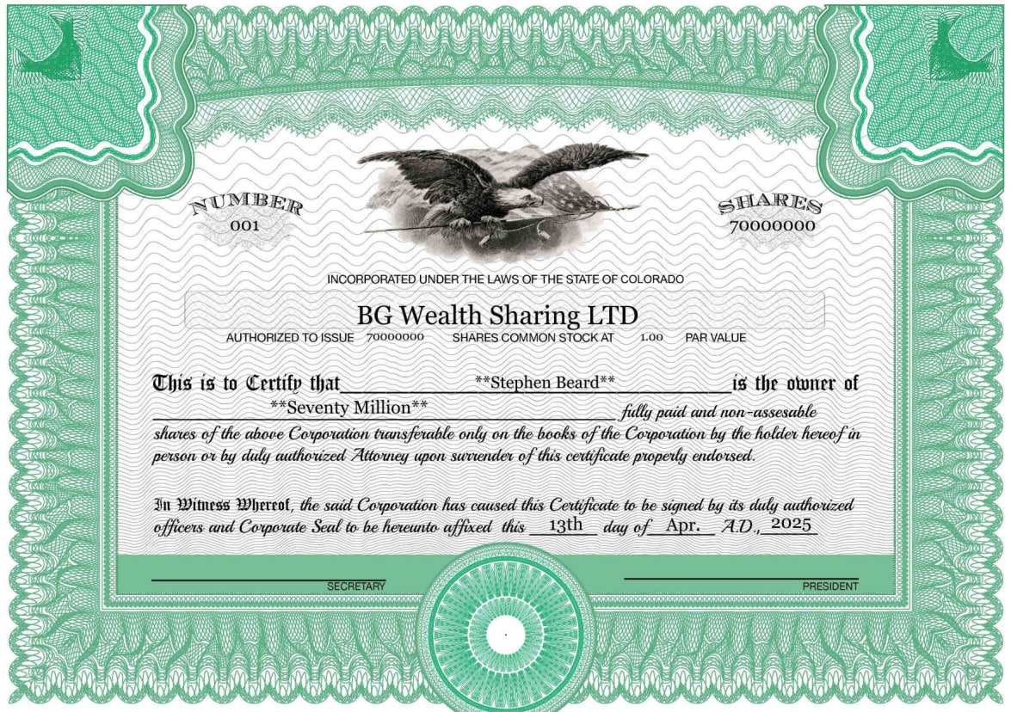
ADVANTAGE THREE
BG WEALTH SHARING GROUP

Slide 12
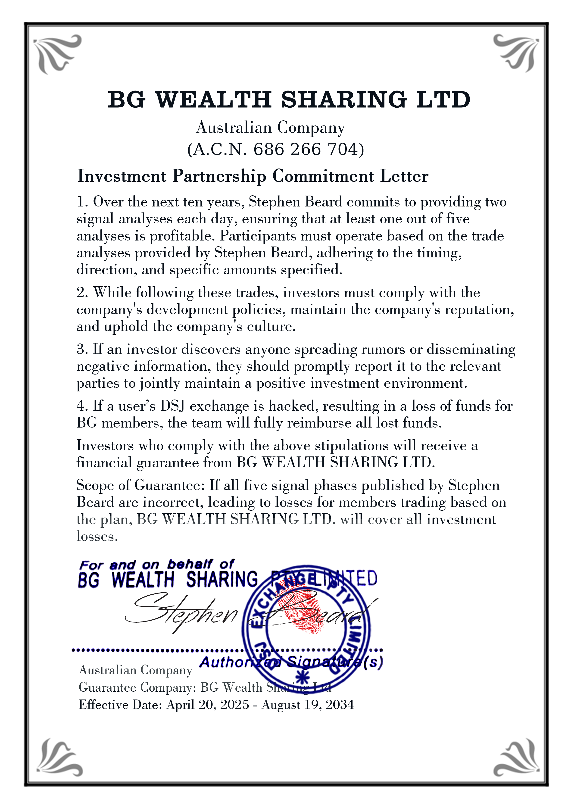
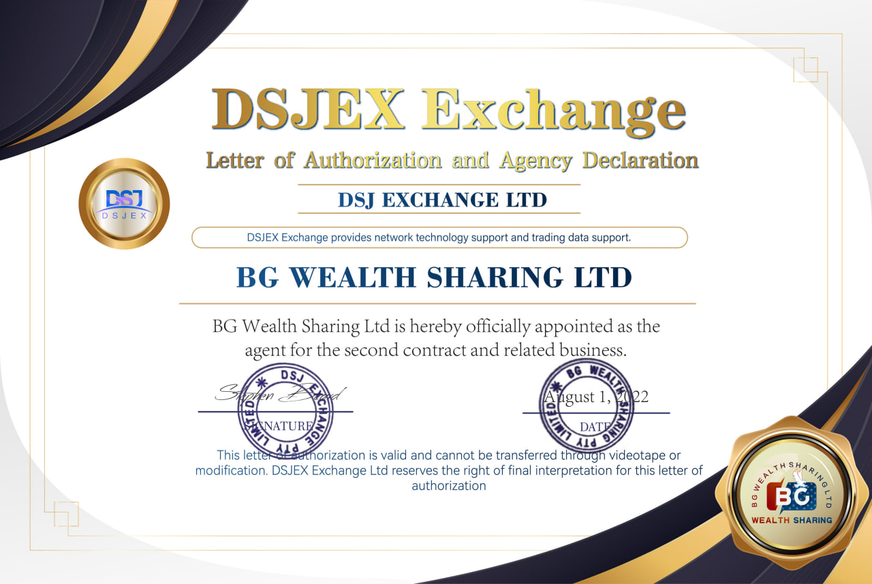
ADVANTAGE FOUR
Long-term project cooperation. The Wealth Sharing Fund team
signed a ten-year cooperation plan with DSJEX, adhering to the
core concept of tripartite cooperation and win-win.
DSJ: Digital Policy Connection
Meaning: refers to the intersection of different strategies, methods or technologies in the digital age. It is a key node for enterprises or organizations to develop and implement digital conversion strategies. This is a critical moment in the transformation of digital networks and online business models, and it is also a place for innovative technologies to be collected.
BG WEALTH SHARING GROUP

Slide 13
ADVANTAGE FOUR
BG WEALTH SHARING GROUP

Slide 14
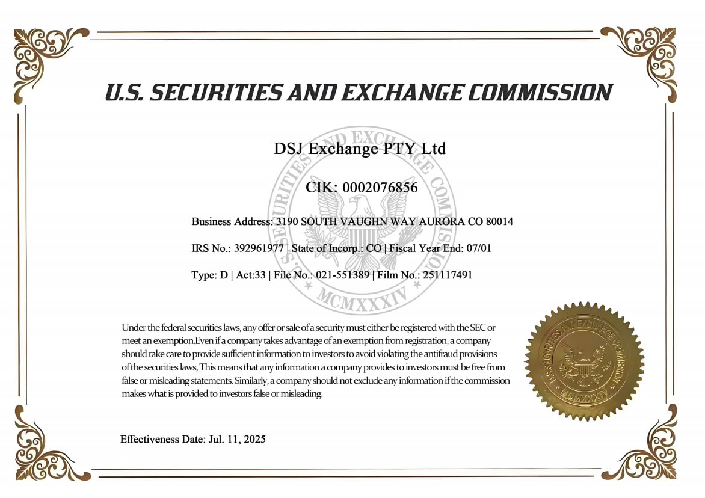
ADVANTAGE FOUR
DSJEX Exchange's acquisition of the U.S. Securities and Exchange Commission (SEC) license marks that it has reached high standards of compliance operations, which not only injects momentum into the development of the platform, but also reshapes the market's trust in the exchange and pushes the industry towards a healthy and transparent development track. This move will open up the international market for DSJEX, attract more institutional investors, improve user fund security and transparency, and provide a more trustworthy trading environment for the majority of users. Overall, this progress is not only a victory for DSJEX, but also a new starting point for promoting the compliance development of the entire crypto asset industry, redefining the standards for future platforms.
BG WEALTH SHARING GROUP

Slide 15
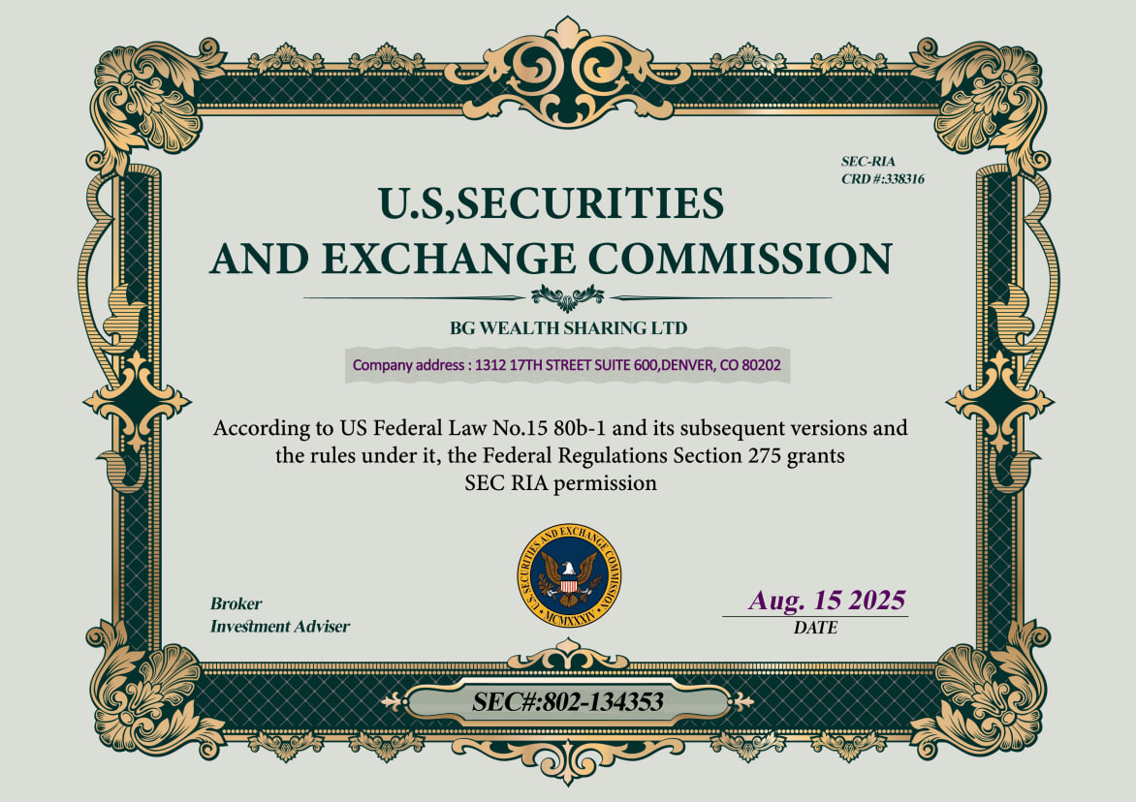
ADVANTAGE FOUR
On August 15, 2025, BG Wealth Sharing LTD was honored to announce its successful acquisition of a U.S. RIA (Registered Investment Advisor) license. This significant achievement marks further advancement in the wealth management field and demonstrates the firm's expertise in compliance, risk management, and investment strategy. With this certification, we will provide clients with more comprehensive and transparent wealth management services, helping them achieve their financial goals and optimize their investment returns. BG Wealth Sharing LTD will continue to uphold integrity and innovation, committed to creating long-term value for our clients.
BG WEALTH SHARING GROUP

Slide 16
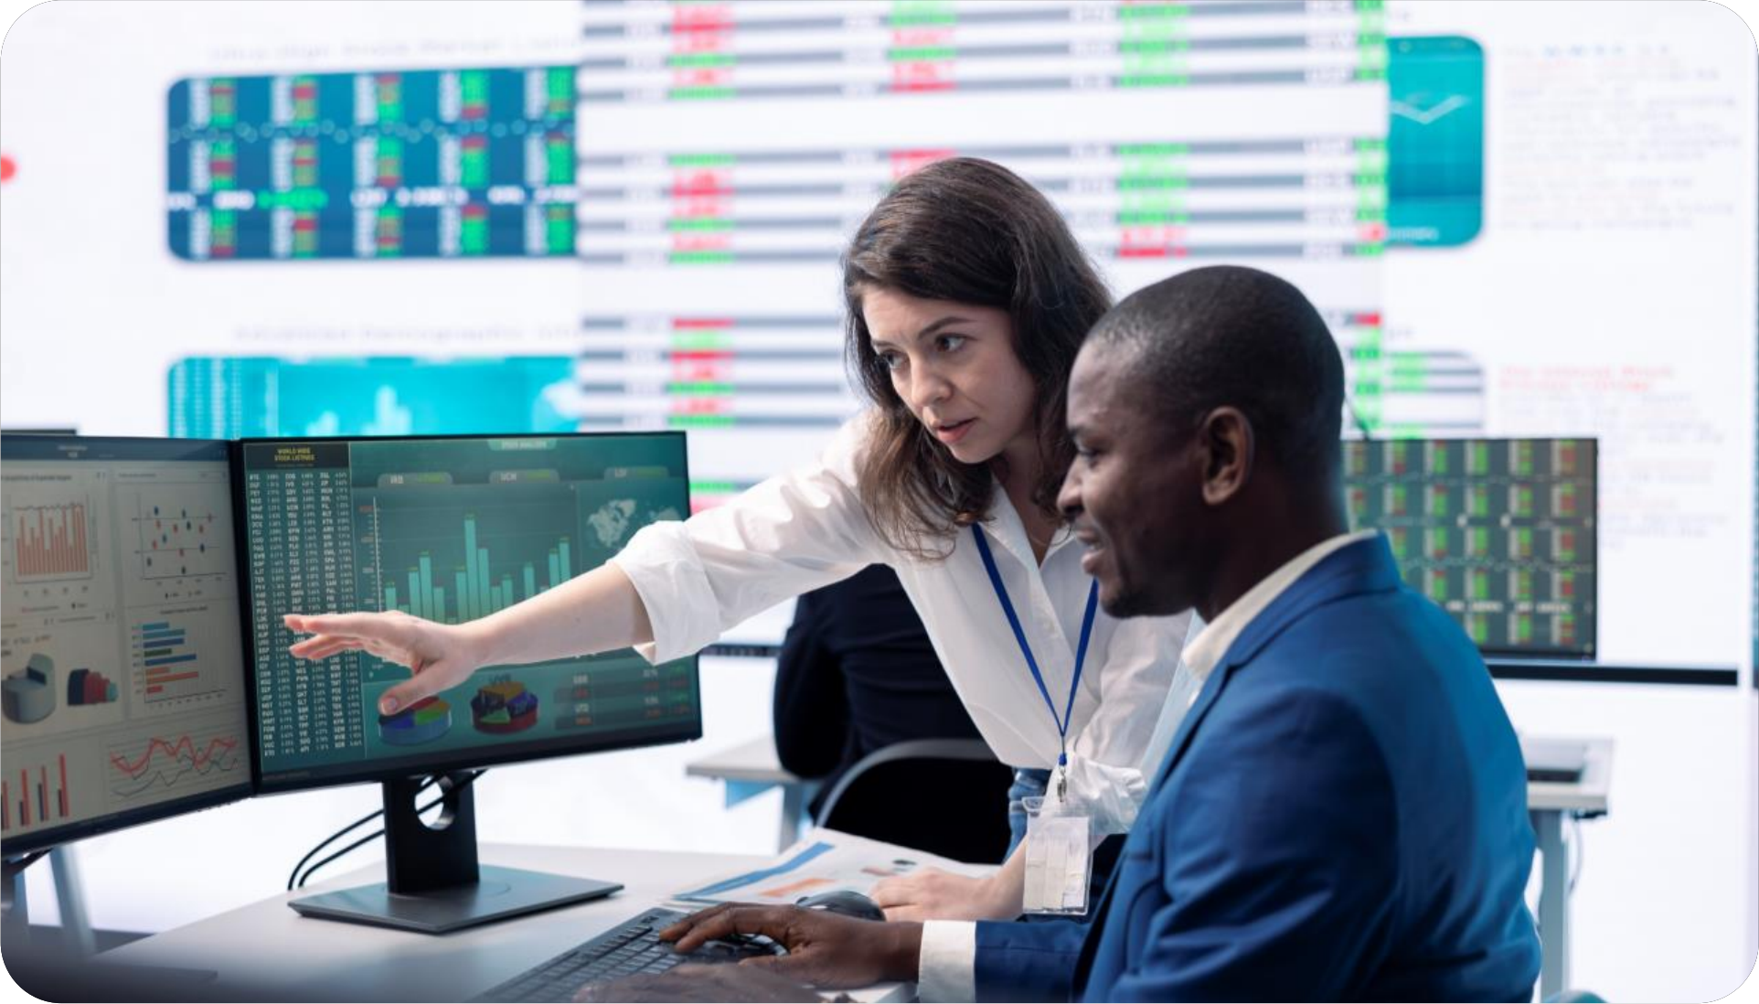
ADVANTAGE FIVE
IN ADDITION TO PROFITING FROM SIGNAL TRADING,
YOU CAN ALSO BUILD A TEAM TO EARN ADDITIONAL PROFITS.
BG WEALTH SHARING GROUP

Slide 17
ENDORSEMENT
REWARDS
New User Recharge Amount(USDT) | Referrer Bonus (USDT) | Newcomer Reward (USDT)
500 | 25 | 25
1000 | 100 | 50
3000 | 300 | 150
5000 | 500 | 250
If a spokesperson invites a friend to join and the recharge is less than 300 USDT
the spokesperson receives no reward.
If a friend invited by the spokesperson joins and their first recharge reaches 500 USDT
both the Spokesperson and the new member will receive an additional special training signal bonus as well as a Newcomer Bonus and a Referral Bonus.
BG WEALTH SHARING GROUP

Slide 18
TEAM BUILDING
Endorse 5 people to form a group and enjoy trading
volume dividends
Position/evel | Number | Bonus ratio | cycle bonus | level-up rewards
Junior Spokesperson | Directly reports 5 people | 0.50% | $30 | $100
Intermediate Spokesperson | 2 direct reports LV1 / Team of 25 | 1.00% | $150 | $300
Senior Spokesperson | 3 direct reports LV1 / Team of 125 | 2.00% | $500 | $800
One-Star Spokesperson | 4 direct reports LV1 / Team of 500 | 2.50% | $1200 | $2000
Two-Star Spokesperson | 5 direct reports LV1 / Team of 1000 | 3.00% | $2400 | $5000
Three-Star Spokesperson | 6 direct reports LV1 / Team of 2000 | 3.50% | $5000 | $12000
Regional Spokesperson | 7 direct reports LV1 / Team of 5000 | 4.00% | $10000 | $25000
1
1. When the team meets the dividend conditions, each recommender can apply for dividends on the 9th, 19th, and 29th of each month based on the trading volume of his or her downline members (the downline members' deposits must be greater than 300 USDT). The higher the trading volume, the more dividends. If the dividend is less than 30 USD, it will be rewarded at 30 USD.
2
Each recommender in a leadership position can apply for a birthday allowance once a year.
(Birthday allowance: 100 USDT).
3
Recommenders in each position must lead team members responsibly. The team is prohibited from spreading rumors or negative information. Once it is confirmed that someone has spread rumors, the team will cancel all benefits after verification.
4
Recommenders in each position need to diligently lead the team development and work hard to support each subordinate member. For each subordinate who successfully promotes a junior recommender position, the supervisor recommender will receive a team reward of 50 USDT!
5
Teams in senior recommender positions can apply for a monthly team gathering to promote team building and development. Gathering expenses must be reimbursed (reimbursement must be arranged in advance with the team project manager and approved by the team project manager).
6
Trading volume dividends (uniform distribution time: 9th, 19th and 29th of each month), please apply to the project manager, who will review and arrange distribution The manager upgrade reward can be directly requested from Professor Stephen.
BG WEALTH SHARING GROUP

Slide 19
VOLUME DIVIDENDS
If you successfully invite 5 new friends to join, and each of them invests more than $300, you will be promoted to Level 1 Manager and receive a $100 promotion bonus. This means that your leadership and team development skills are recognized. Manager bonuses are paid three times a month, on the 9th, 19th and 29th. Bonus rewards are a direct return on the successful growth of your team, and your income will continue to increase as you add more team members.
The dividends are divided according to different
levels as shown below.
1
1. When the team meets the dividend conditions, each recommender can apply for dividends on the 9th, 19th, and 29th of each month based on the trading volume of his or her downline members (the downline members' deposits must be greater than 300 USDT). The higher the trading volume, the more dividends. If the dividend is less than 30 USD, it will be rewarded at 30 USD.
2
When the team reaches 25 members, you will be promoted to LV2 manager and receive a promotion bonus of $300. In addition, you will receive a 1% dividend on the team's trading volume every 10 days, three times a month.
3
If your team reaches 1,000 people, you can upgrade to LV5 manager and you can get a promotion reward of 5,000 USDT. [1,000-person team: daily trading volume 1,000*100=100,000 USD, manager's 10-day trading volume 1 million*3%=30,000 USD, equivalent to the annual salary of an ordinary worker] success rate. (This is calculated based on the number of team members, for example, the trading volume of 1,000 and 3,000 investments is different)
BG WEALTH SHARING GROUP

Slide 20
Dynamic Signal Rewards:
If you invest $1,000, 2 days of signal trading can help you realize a profit of $65. If you invest $3,000, you might get $195 in profit.
When you invite a friend to invest more than $500, both you and the new member will receive 6 bonus dynamic trading signals. In addition, you can participate in 6 signal transactions and receive 2 dynamic signals at 2 pm and 2:30 pm, and another 2 dynamic signals at 8:30 pm and 9 pm every day.
It should be noted that the dynamic trading signals provided by the referrer are proportional to the initial deposit amount of the new member, that is, the trading volume accounts for 1%. If you are unable to participate in 2-day signal trading, you can contact me or my assistant for more details and accumulate your transactions.
Dynamic Signal Return
As long as you invite friends to join BG, your daily earnings will be very high.
Signal trading is just our basic income, while team income allows us to achieve greater success in the future. A good investor must know how to broaden their perspective. Investment depends on developments over the coming years. I joined the BG Wealth Sharing Team in 2022. From starting as an individual to now becoming a regional spokesperson, my journey from not knowing how to operate at first to achieving success has been made possible with the support of Professor Stephen. I hope you can create your own team just like I did and become wealthier in the future
BG WEALTH SHARING GROUP

Slide 21
VOLUME DIVIDENTS
Manager
A1
(Immediate members)
A2
(Immediate members)
A3
(Immediate members)
A4
(Immediate members)
A5
(Immediate members)
B
1
B
2
B
3
B
4
B
5
B
1
B
2
B
3
B
4
B
5
B
1
B
2
B
3
B
4
B
5
B
1
B
2
B
3
B
4
B
5
B
1
B
2
B
3
B
4
B
5
The Wealth sharing Foundation is the entrepreneurial starting point for each member!
1
With you as the core point of the team manager, the constant cascade of replication into Foundation Advocate positions will grow in multiples of 5!
2
The first tier of 5, the second tier of 25, the third tier of 125, the fourth tier of 625, the fifth tier of 3125, and so on, when your team reaches the level of 10,000 people, you will be able to earn more than $100,000 per month!
3
According to the concept of five people into a group, management and guidance of each layer of personnel, teaching the correct investment concept, team win-win cooperation concept, common development team, to help each layer of members are able to earn their own a stable income!
duplication is an unsurpassed entrepreneurial myth!
BG WEALTH SHARING GROUP

Slide 22
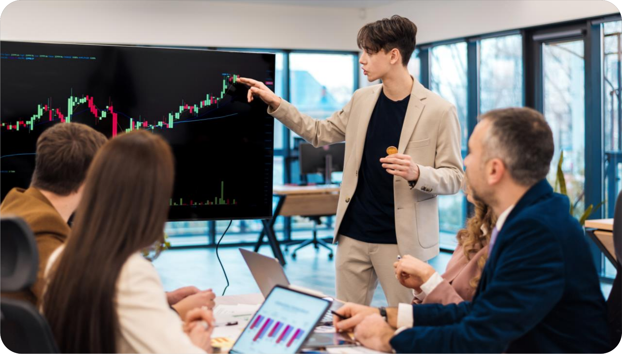
How We Complete the Trades
Let's assume we start with $500, make two trades a day of 1% value, and earn at least $6.50 a day on average. This brings our total to $506.50. On the second day, we earn $6.58, so the profit for two days is $13.08.
BG WEALTH SHARING GROUP
BG WEALTH SHARING GROUP

Slide 23
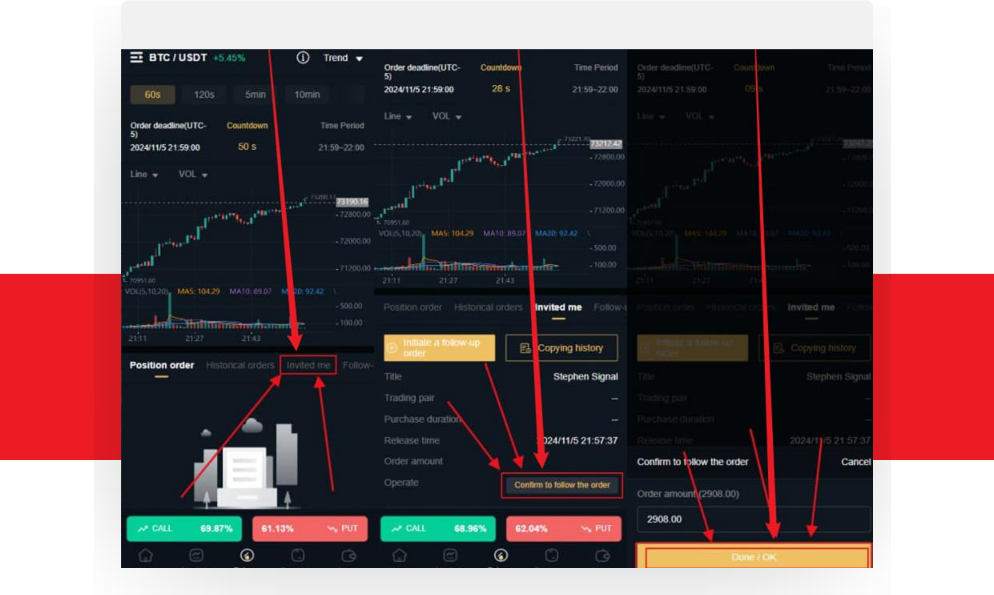
HOW WE FOLLOW THE
TRADING SIGNALS
1%
We follow the trading signals by going into the Invited me page and pressing the’ Confirm to follow the order button within the DSJEX app.
There is no manual selecting of the amounts or types etc., just simply press the one button to follow the trade.
This automatically sets the correct product, whether it’s a call or put and the 1% amount of our total balance,
Step 01
Step 02
Step 03
BG WEALTH SHARING GROUP

Slide 24
WHAT IF THE
TRANSACTION FAILS?
As we have a trading accuracy of up to 99.6%, it's very unlikely that a trade would lose, however if it does we go by a 5 phase plan to trade again for a higher percentage to cover any losses:
Funds | Phase 1 | Phase 2 | Phase 3 | Phase 4 | Phase 5
$605 | $5 | $15 | $45 | $135 | $405
Profit | $3.25 | $4.75 | $9.25 | $22.75 | $63.25
UNIT
LEVEL 01
Funds | Phase 1 | Phase 2 | Phase 3 | Phase 4 | Phase 5
$1210 | $10 | $30 | $90 | $270 | $810
Profit | $6.5 | $9.5 | $18.5 | $45.5 | $126.5
UNIT
LEVEL 02
Funds | Phase 1 | Phase 2 | Phase 3 | Phase 4 | Phase 5
$3630 | $30 | $90 | $270 | $810 | $1800
Profit | $19.5 | $28.5 | $55.5 | $136.5 | $379.5
UNIT
LEVEL 03
BG WEALTH SHARING GROUP

Slide 25
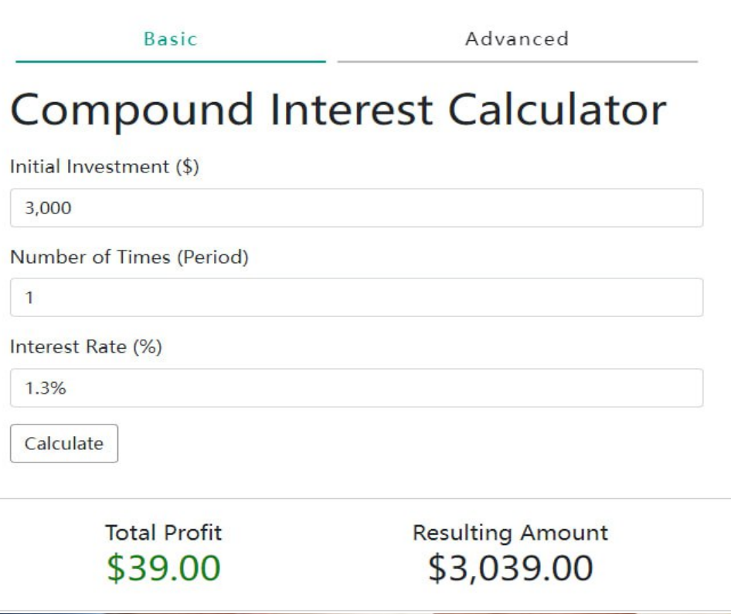
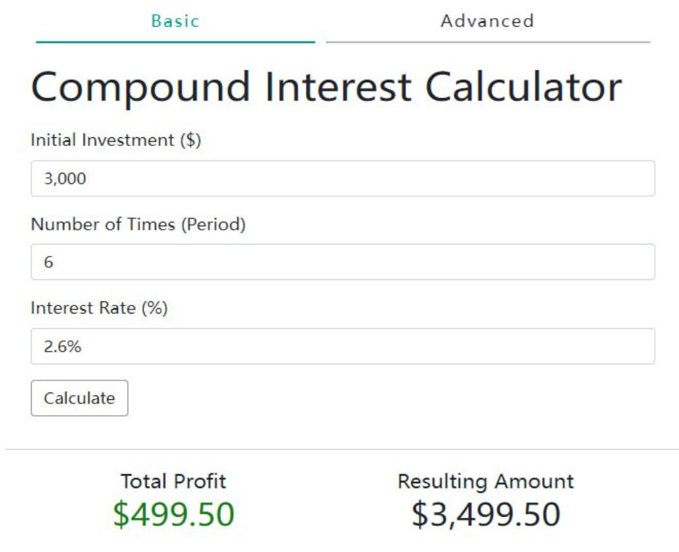
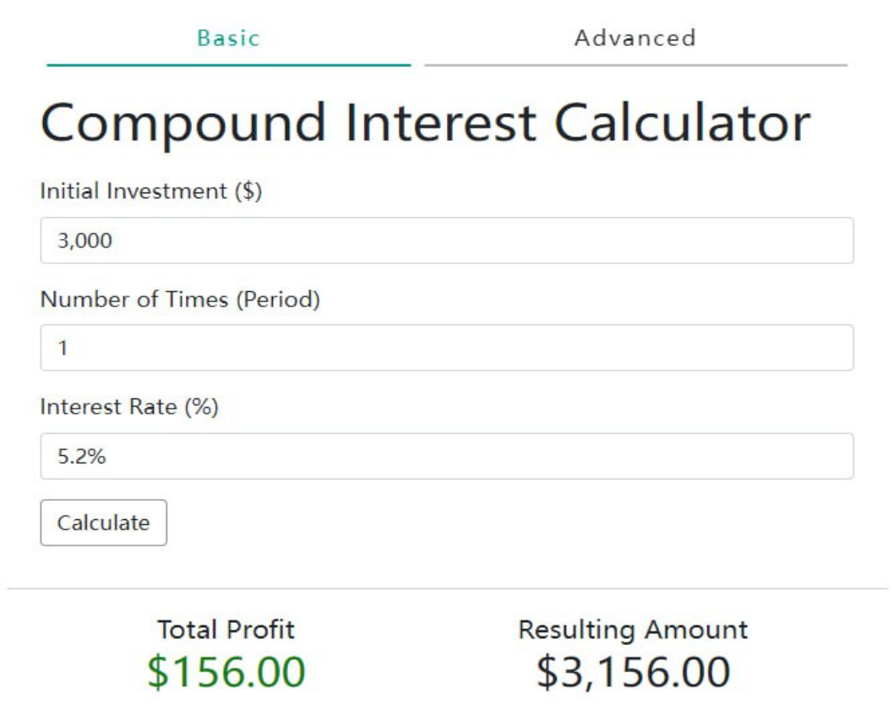
DYNAMIC & STATIC RETURNS
If you invite five new members within a week and deposit at least $500, you will not only earn at least $250 as an invitation bonus, but you will also successfully build your own team and elevate your team to the position of Junior Manager. Based on the number of team members, you will receive a total of three bonus rewards on the 9th, 19th, and 29th of each month.
1.3% Daily Return
As everyone knows, BG Group offers two fixed signals, which provide investors with basic returns after joining. If your DSJEX account balance is $3,000, the daily returns from these two fixed signals would be $39. That is equivalent to what an average person might earn in a day or two, allowing you to enjoy stable returns every day.
Second: Daily Return
Many people do not understand how a 2.6% return works. Let me explain - We have 2 fixed signals plus 2 additional signals that enable us to achieve a 2.6% return . If you want to receive 3 additional signals, you need to invite new members to invest and join. The new members’ investment must reach a minimum deposit of $500.
For example
if you have $3,000 in funds, you can receive 6 additional signals each day, plus 2 fixed signals from BG, making a total of 8 signals. The daily return exceeds 5.2%.
BG WEALTH SHARING GROUP

Slide 26
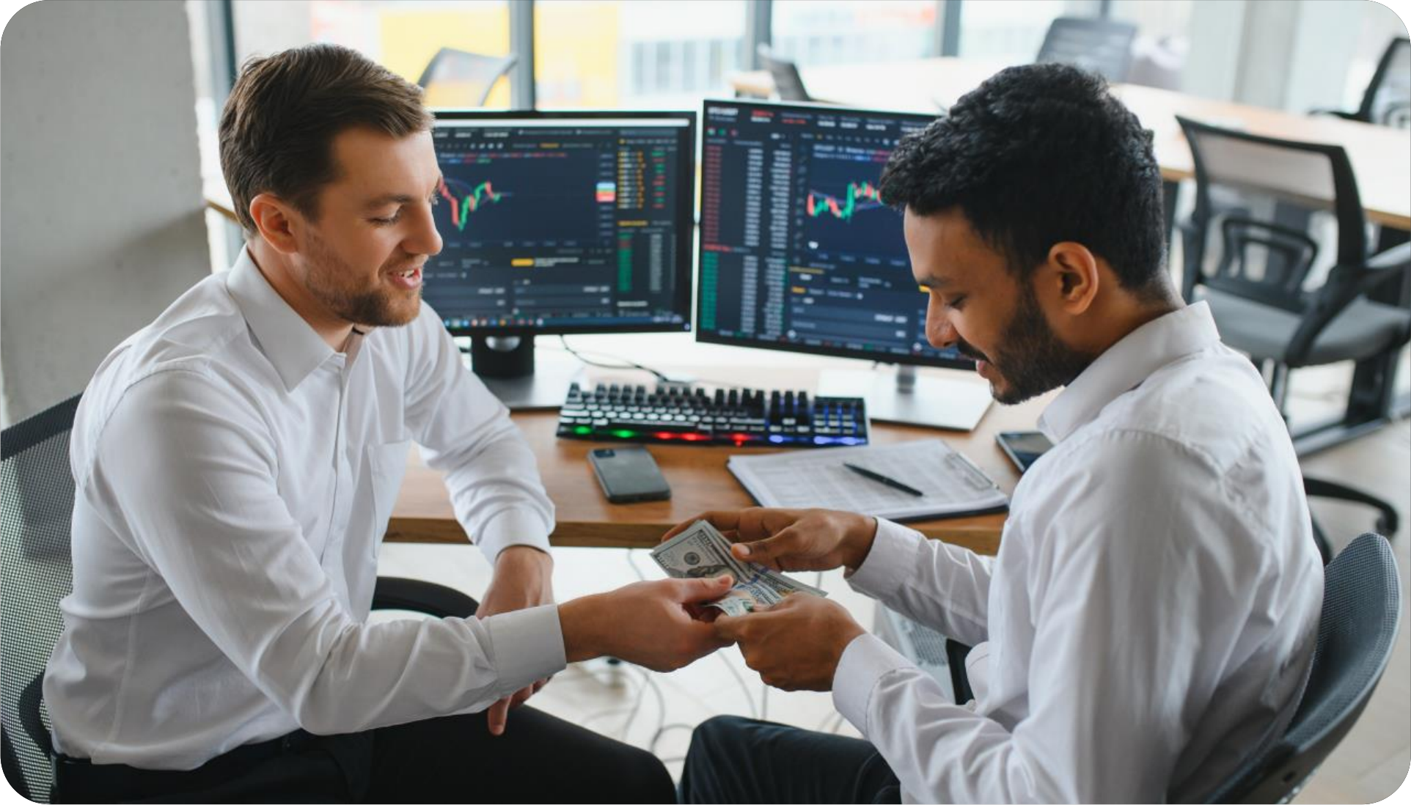
DYNAMIC & STATIC RETURNS
LET’S COMPARE THE DYNAMIC AND
STATIC RETURNS YOU CAN GET
BASED ON YOUR DEPOSIT AMOUNT
AND YOUR REFERRAL BONUS.
BG WEALTH SHARING GROUP
BG WEALTH SHARING GROUP

Slide 27
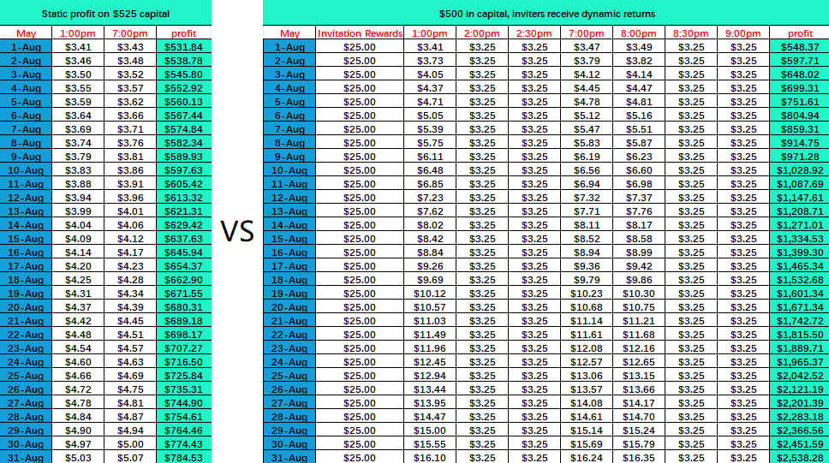
Investing $500: Comparing static returns with dynamic returns over a period of 31 days.
Newly joined members can make an initial deposit of $500, and the inviter can receive a $25 referral bonus.
BG WEALTH SHARING GROUP

Slide 28
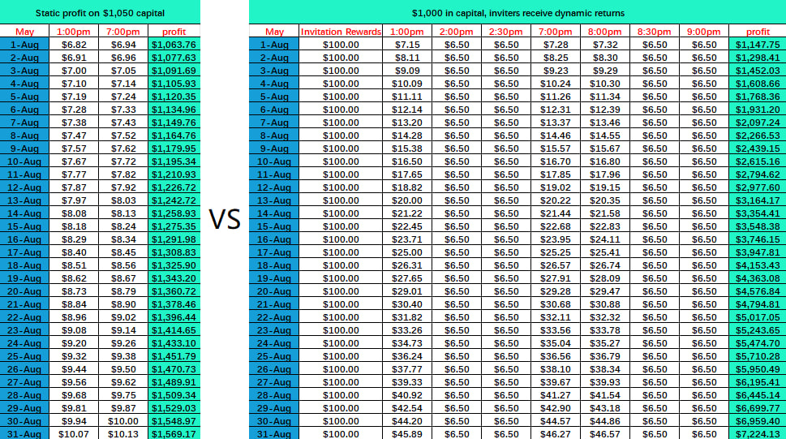
Investing $1000: Compare static returns with dynamic returns over a period of 31 days.
Newly joined members can make an initial deposit of $1,000, and the inviter can receive a $100 referral bonus.
BG WEALTH SHARING GROUP

Slide 29
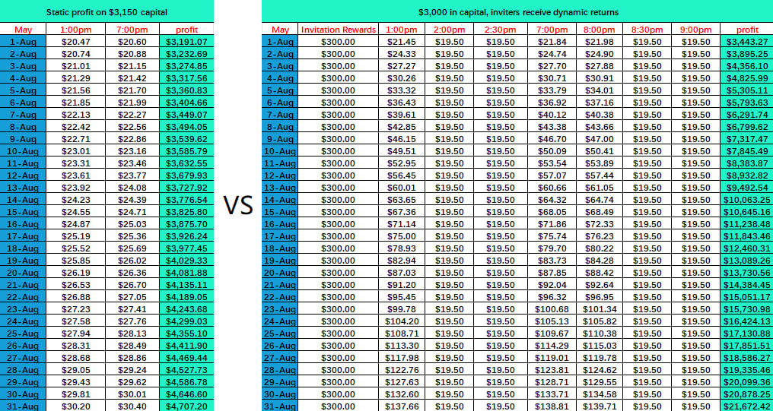
Investing $3,000: Compare static returns and dynamic returns over 31 days.
Newly joined members can make an initial deposit of $3,000, and the inviter can receive a $300 referral bonus.
BG WEALTH SHARING GROUP

Slide 30
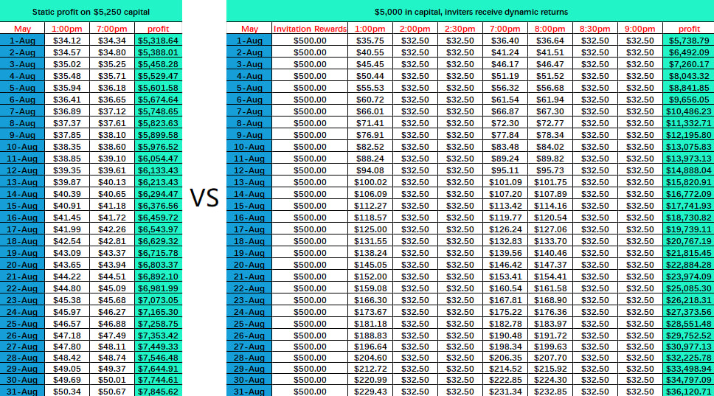
Investing $5,000: Comparing Static Returns with Dynamic Returns Over 31 Days.
Newly joined members can make an initial deposit of $5,000, and the inviter can receive a $500 referral bonus.
BG WEALTH SHARING GROUP

Slide 31
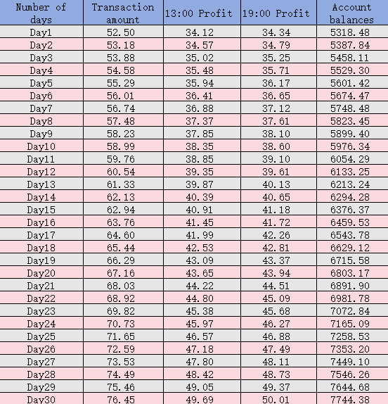
$5000 START FOR 30 DAYS -
STATIC EARNINGS
A new user who deposits 5,000 USD for the first time can get a 250 USD reward. The account balance is 5,250 USDT, so the first transaction amount is 52.50
BG WEALTH SHARING GROUP

Slide 32
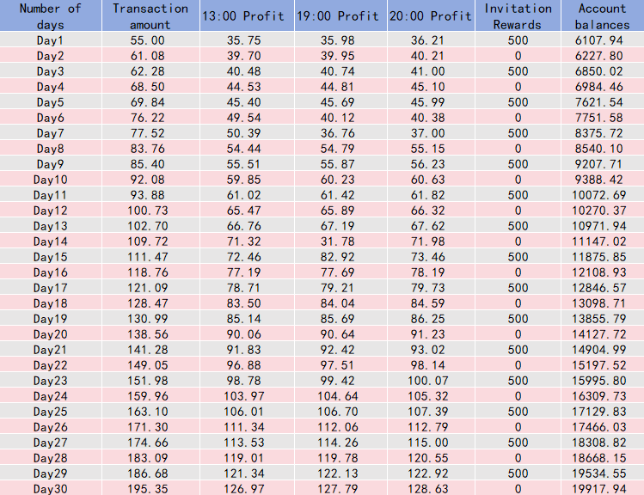
$5000 START FOR 30 DAYS -
STATIC EARNINGS
Newcomers are rewarded $500 for their first invite and have an account balance of 5500USDT, so their first trade amount is 55.00
BG WEALTH SHARING GROUP

Slide 33
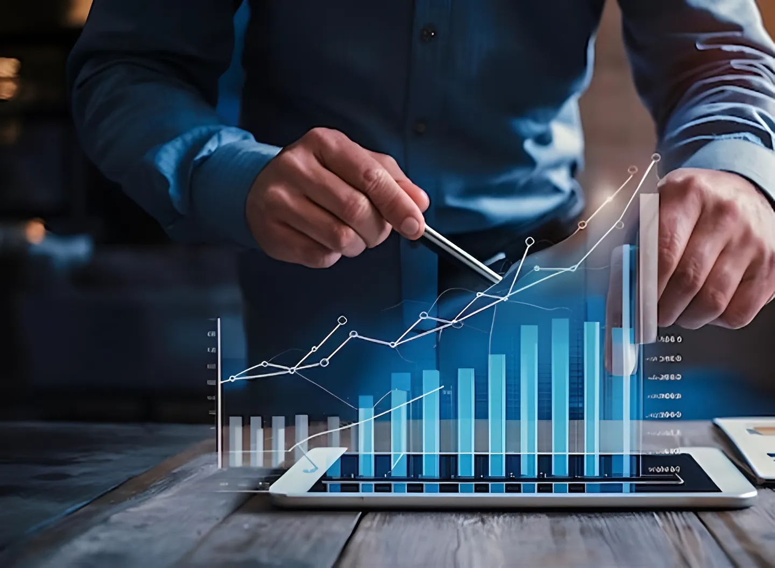
THANKS

